Slide 1
Segmenting the jaw on planning CT: how we would reproduce IMPACT
SEMESTER 5 · IMPLEMENTATION STUDY · TMH OSTEONECROSIS AI PROJECT
A study of the MD Anderson IMPACT paper (medRxiv 2025): what its public CT data and code contain, what our own exploration of the 60 scans shows, and what it would take to train the models ourselves.
60
44
0.85
planning CT scans in the public release
structures: 12 jaw sub-volumes + 32 teeth
best reported Dice (mandible basal)
Muaaz, Vaishnavi, Kashish, Kamakshi · Guide: Vaishali Kulkarni · Tata Memorial Hospital, Mumbai · November 2026 · github.com/MuaazSM/orn-pipeline
Notes:
Title. This is a study and implementation plan; no model was trained for this report.

Slide 2
One mandible contour becomes 44 structures
01 · THE PAPER
IMPACT auto-segments the jaw on radiotherapy planning CT. Instead of treating the mandible as one organ, it splits the mandible and the maxilla into left, central and right alveolar and basal regions, and labels every tooth.
Task | Structures | Model in the paper
Mandible | 6 sub-volumes | Swin UNETR, one stage
Maxilla | 6 sub-volumes | ResUNet ROI, then Swin UNETR
Teeth | 32 teeth (ADA 1–32) | ResUNet ROI, then Swin UNETR
Why split the bone
Alveolar bone around the teeth is trabecular and more radiosensitive; basal bone is denser cortical bone.
The regions follow the ClinRad ORN staging system, which grades the vertical extent of bone damage.
Dose can then be read per region and per tooth, for example before a dental extraction.
Scope check
The scans are CT, not MRI. The release supports segmentation only: it has no clinical variables and no ORN outcomes, so it cannot be joined to our ORN-grade model directly.
Humbert-Vidan L, Castelo AH, He R, et al. IMPACT. medRxiv 2025. doi:10.1101/2025.03.18.25324199

Slide 3

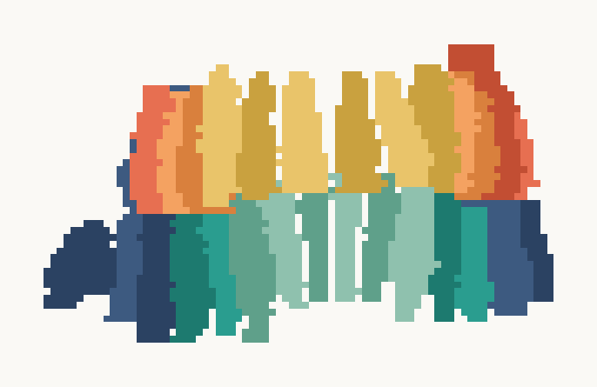
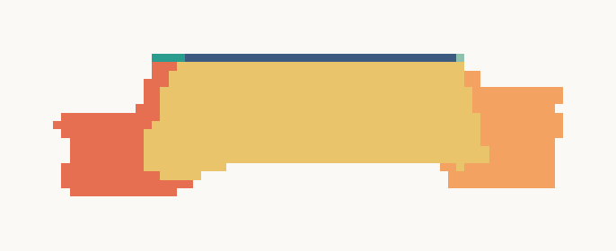
The release: 60 CT scans, each with three label maps
02 · PUBLIC DATA
File | Contents | Size
mandible.zip | 60 CT + mandible masks | 1.87 GB
maxilla.zip | same 60 CT + maxilla masks | 1.87 GB
teeth.zip | same 60 CT + teeth masks | 1.87 GB
dose_test_cases.zip | RT dose, 8 test patients | 4 MB
Mandible: 6 sub-volumes
Maxilla: 6 sub-volumes
Teeth: 32 labels
Right basal
Central basal
Left basal
Every zip repeats the same CT images, so the unique imaging is 1.9 GB.
All 180 masks sit on their CT's voxel grid (checked).
No train/test split file, no clinical table and no ORN outcome.
Right alveolar
Central alveolar
Left alveolar
Viewed from the front: the patient's right is on the left of each image. Alveolar regions sit next to the teeth, basal regions below (mandible) or above (maxilla).
figshare doi:10.6084/m9.figshare.28615874 (CC BY 4.0) · front views are first-hit projections of patient 3's labels

Slide 4
Same in-plane grid, varied slice spacing and length
03 · EXPLORATORY DATA ANALYSIS
0.98 mm
412 mm
in-plane pixels in 38 of 60 scans; the rest 1.04–1.37 mm, so resampling to 1 mm is needed
median scan length (278–570 mm), 101 to 296 slices
25 M
40 of 60
voxels per scan after the paper's resampling and body crop (14–36 M)
scans have metal-range voxels (> 3,000 HU) in the jaw, so streak artefacts are in the training data
All 60 scans read voxel by voxel · resampling and body crop follow the authors' code (1 × 1 × 2 mm, foreground HU > 0)

Slide 5
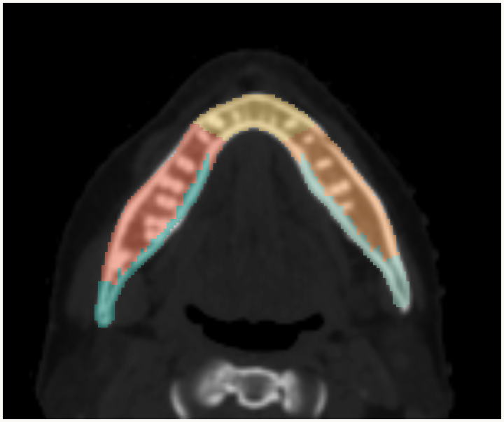
Maxilla basal bone is missing from half the scans
03 · EXPLORATORY DATA ANALYSIS
Region | Mandible | Maxilla
R basal | 60 | 26
C basal | 60 | 29
L basal | 60 | 25
R alveolar | 60 | 60
C alveolar | 60 | 60
L alveolar | 60 | 59
Scans (of 60) containing each region
Axial CT with the six mandible sub-volumes overlaid
Lateral maxilla basal regions are 0.1 cc at the median. The paper reports that these were not segmented successfully.
Median volume over scans where the region is present · side from the NIfTI orientation · axial slice of patient 3

Slide 6
42% of molar positions are empty
03 · EXPLORATORY DATA ANALYSIS
% of patients with each tooth present (ADA Universal numbering 1–32)
Group | Present | Dice
Upper central | 99% | 0.80
Upper premolars | 85% | 0.69
Upper molars | 52% | 0.76
Lower central | 99% | 0.76
Lower premolars | 89% | 0.70
Lower molars | 64% | 0.63
Upper
1
10
2
38
3
87
4
80
5
90
6
100
7
98
8
100
9
100
10
97
11
98
12
90
13
82
14
75
15
82
16
18
Lower
32
53
31
78
30
78
29
87
28
92
27
100
26
98
25
98
24
98
23
100
22
100
21
92
20
85
19
82
18
73
17
20
← Patient's right
Patient's left →
Median 27 of 32 teeth per patient (range 14–32); 6.2 missing on average, matching the paper's Table 1. Third molars (1, 16, 17, 32) are present in only 25% of patients.
Lower molars are both the least often present lower teeth and the lowest Dice. Upper molars do better than their presence suggests, so missing teeth are one factor, not the whole story.
Present = tooth label non-empty in the mask (n = 60) · Dice from the paper's Table 2 (test set, n = 10)

Slide 7
Jaw dose is lopsided: up to 42 Gy left to right
03 · EXPLORATORY DATA ANALYSIS
Case | Right basal (Gy) | Left basal (Gy) | Gap (Gy)
15 | 14.4 | 56.0 | 41.6
34 | 47.7 | 7.7 | 40.0
40 | 46.8 | 26.3 | 20.5
36 | 34.3 | 44.1 | 9.8
38 | 44.1 | 53.5 | 9.5
35 | 21.4 | 22.7 | 1.3
37 | 38.7 | 39.2 | 0.5
A single whole-mandible mean would hide this. Splitting by side, and alveolar from basal bone, keeps it.
Data issue
Case 32's dose file peaks at 16,384, about twice the prescription, with a quarter of voxels above 80 Gy. Likely a scaling error, so it is left out.
Mean dose (Gy) of the plan resampled onto the manual masks · 7 of 8 dose cases (case 32 excluded, see text)

Slide 8
Three models share one preprocessing chain
04 · METHOD
01
02
03
04
Convert
Resample
Normalise
Augment
CT and RT structures from DICOM to NIfTI; overlaps go to the central region
1 × 1 × 2 mm voxels, then crop to the body outline
Clip HU to −200…1,600 to show bone, rescale to 0–1
Rotate ±12°, scale ±10%, intensity ±10%; four random 96³ patches per scan
Mandible
Swin UNETR whole scan, 7 labels
→ 6 sub-volumes
Maxilla
Stage 1 · ResUNet maxilla as one ROI
→
Crop 128³ at ROI centre of mass
→
Stage 2 · Swin UNETR 7 labels
→ 6 sub-volumes
Teeth
Stage 1 · ResUNet all teeth as one ROI
→
Crop 128³ at ROI centre of mass
→
Stage 2 · Swin UNETR 33 labels
→ 32 teeth
TRAINING 5-fold CV on 50 scans · 500 epochs · Dice + cross-entropy loss, lr 10⁻⁴ → majority vote of the 5 fold models → 10 test scans: Dice, mIoU, HD95, ASD; dose vs manual (Wilcoxon, Bonferroni)
As described in the paper, sections 2.3–2.6 · MONAI (PyTorch) throughout

Slide 9
The public code is a snapshot, not a pipeline
05 · CODE AUDIT
Topic | Paper says | Public code does
Network | Swin UNETR | SwinUNETR import is commented out; builds MONAI UNETR or a residual UNet
Epochs | 500 | 500 for mandible and maxilla; 1,000 in both teeth scripts
Stage-2 crop | From the stage-1 output | Training and validation crops are centred on the ground-truth mask
Test-time steps | Majority vote; Dice, mIoU, HD95, ASD; dose | None of these are in the repository
Data split | Random 50 / 10 | Depends on unsorted os.listdir order (seed 0)
Paths and hardware | — | Hard-coded MD Anderson cluster and Windows paths; CUDA or CPU only
Packaging | — | No README, requirements, trained weights, inference script or resume
What this means for us: the repo shows the authors' settings, but we have to write the pipeline that joins the stages, runs the ensemble and computes the metrics.
Audit of all five seg_model.py files in github.com/dr-mnaser/orodental-segmentation (1 commit, June 2025)

Slide 10
Training IMPACT takes weeks on a laptop, not a day
06 · WHY NOT ON OUR LAPTOPS
25
17,500
5.8 M
15 ms
training runs: 5 stage models × 5 folds
epochs in the code (12,500 per the paper)
96³ patch passes: 2.8 M training + 3.0 M for validation
per patch, the most we could spend to finish in 24 hours
Hardware | Seconds / patch | Time
Laptop CPU (how the code runs on a Mac) | 1–3 | 67–200 days
Apple M-series GPU (needs code changes) | 0.1–0.3 | 7–20 days
One data-centre GPU, e.g. A100 | 0.01–0.03 | 16–48 hours
GPU cluster, folds in parallel (authors) | — | hours per model
Other blockers
The scripts cache 50 resampled scans in memory: about 10 GB, on an 18 GB laptop shared with the OS.
No trained weights are published, so we cannot skip training.
There is no resume, so a laptop going to sleep restarts the run.
Validation: 9.0 M sliding windows, counted at a third of a training pass (forward only).
Workload counted from the authors' scripts and our measured scan sizes · seconds per patch are planning estimates, not benchmarks

Slide 11
Five steps from this study to a working model
07 · IMPLEMENTATION PLAN
STEP 1 · DONE
STEP 2
STEP 3
STEP 4
STEP 5
Data and audit
Clean pipeline
Mandible first
Two-stage models
Evaluate
Release downloaded, all 60 scans explored, code audited (this deck)
One configurable MONAI codebase: saved split, Swin UNETR as in the paper, CUDA / Apple GPU / CPU, resume
One-stage model on a cloud GPU: one fold at reduced epochs to check, then all five
Maxilla and teeth, cropping stage 2 from stage-1 predictions at test time
Dice, mIoU, HD95, ASD against Table 2; dose on the 7 usable dose cases
Proposed code layout
How it connects to our ORN work
Region-level dose (mean and max per sub-volume and tooth) can become new features for the ORN-grade model.
That needs a cohort with both CT and ORN outcomes, for example TMH data; the IMPACT release has no outcomes.
Free cloud GPUs end sessions after hours, so every run must save checkpoints and resume.
impact_study/
configs/ one YAML per task and stage
src/ data, transforms, models, train,
infer, evaluate, dosimetry
outputs/ splits, checkpoints, metrics
Step 1 is complete; steps 2–5 need GPU access

Slide 12
What a successful reproduction should match
08 · TARGETS AND NEXT STEPS
Mean Dice to reproduce (paper, Table 2)
Risks
Mandible basal
0.85
Only 10 test scans, so every Dice has wide uncertainty.
Maxilla basal bone and molars are rare in the data.
Paper and code disagree on network and epochs; we will ask the authors.
Mandible alveolar
0.82
Maxilla alveolar
0.78
Upper central teeth
0.80
Upper premolars
0.69
Next steps
Upper molars
0.76
Get GPU access (college server, TMH or cloud credits).
Build the clean pipeline and train the mandible model first.
Read the MRI segmentation paper our guide will share, and compare.
Lower central teeth
0.76
Lower premolars
0.70
Lower molars
0.63
Lower molars: the abstract says 0.71, Table 2 says 0.63.
Research study. No model was trained for this report. · Code and data: github.com/MuaazSM/orn-pipeline

